Slide 1
E6156 – Topics in SW Engineering (F23) Cloud Computing Lecture 3: REST, PaaS, FaaS, DBaaS, … …
© Donald F. Ferguson, 2023

Slide 2

Contents
2 | E6156 – Topics in SW Engineering: Cloud Computing: Lecture 4 – REST, PaaS, FaaS, DBaaS, … … © Donald F. Ferguson, 2023

Slide 3
Contents
Full Stack Web Application:
Overview
Walkthrough
Mapping Layers to the Cloud
S3, BLOB Store and “Static” Web Content
Overview
Deployment and configuration
Platform-as-a-Service:
Concepts
Elastic beanstalk realization and details
Demo/Example

Slide 4
Full Stack Web Application
4 | E6156 – Topics in SW Engineering: Cloud Computing: Lecture 3 – CDN-PaaS-DBaaS © Donald F. Ferguson, 2023

Slide 5
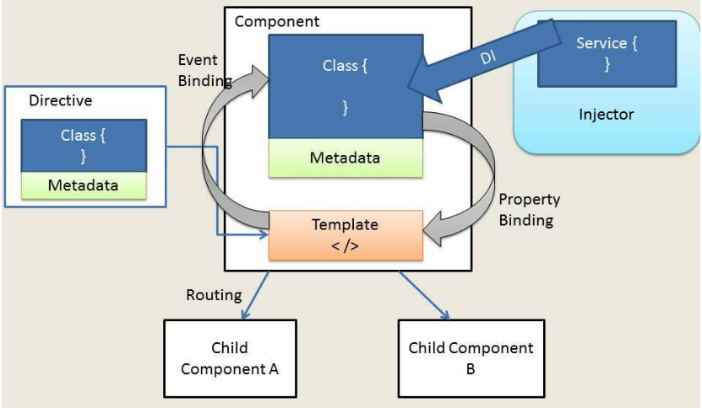
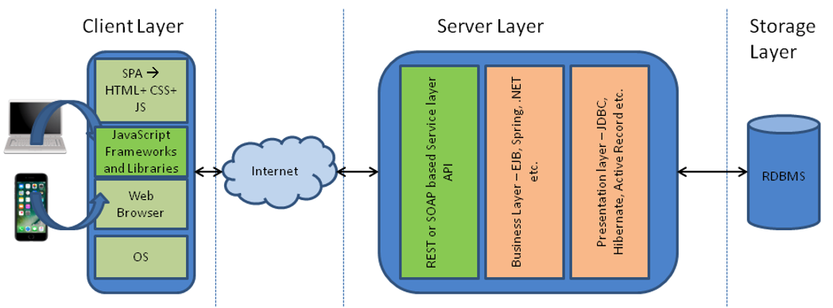
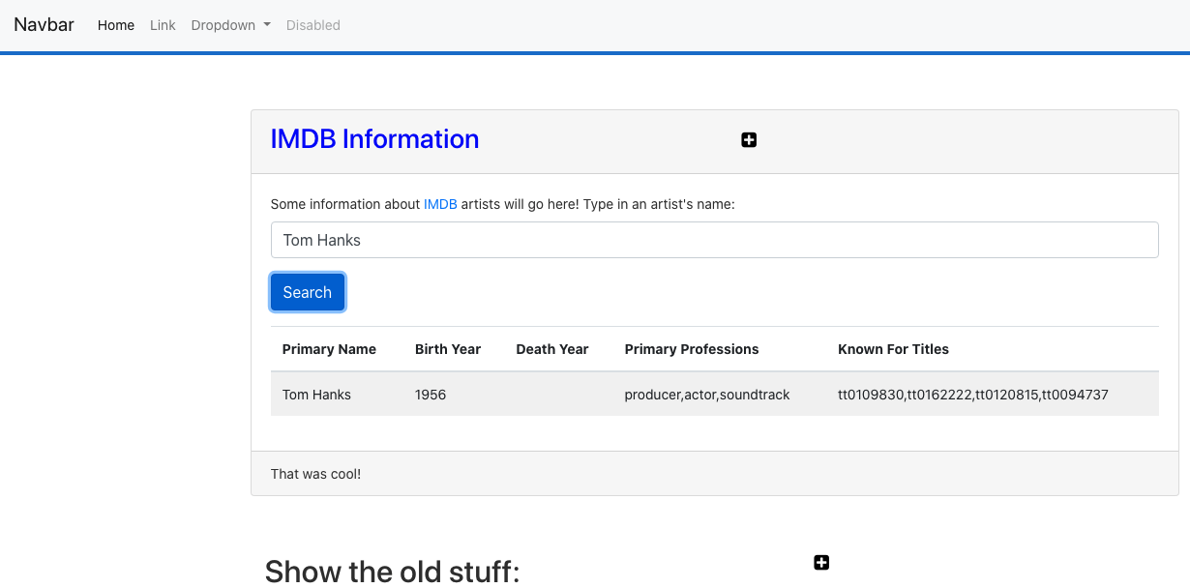
Web Application Architecture
https://dzone.com/articles/architectural-shift-in-web-applications-with-emerg
app.component
navbar.component
imdbartist.component
Template (HTML)
CSS
Component implementation
Service
Show the Code

Slide 6
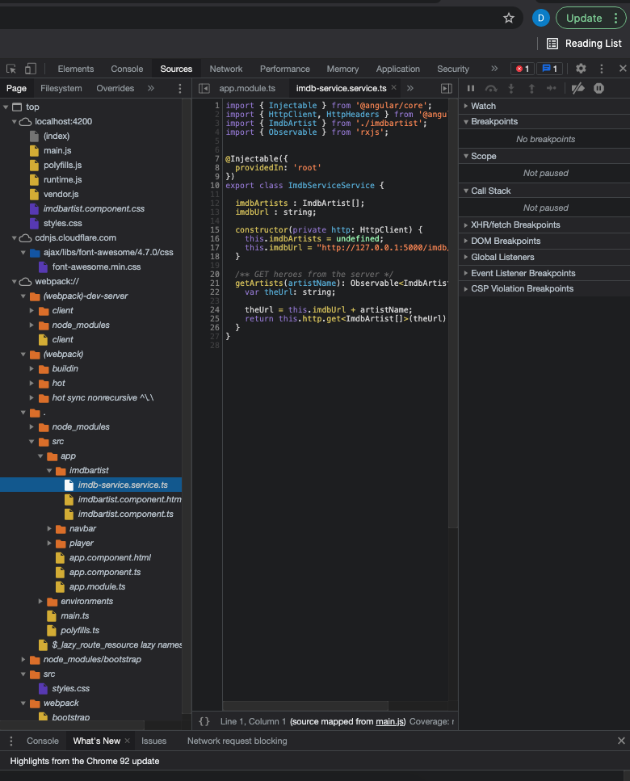
What’s in the Browser
The browser is an application that interprets the files:
HTML, CSS, etc. define the document and content.
JavaScript defines dynamic behavior.
Browser loads index.html
index.html contains links to files.
The browser loads the linked files.
These also have links, which the browser loads.
etc.
How did all of this get in the browser?
A web server delivers these files from “the file system.”
During development, Angular uses a simple, embedded web server.
“build” compiles the files into a webpack (see dist folder)
Deploying the application to the cloud →
We have seen deploying the application logic to the cloud.
What about the content?
Notes:
Show loading the demo-ui.
Show loading cnn.com.

Slide 7
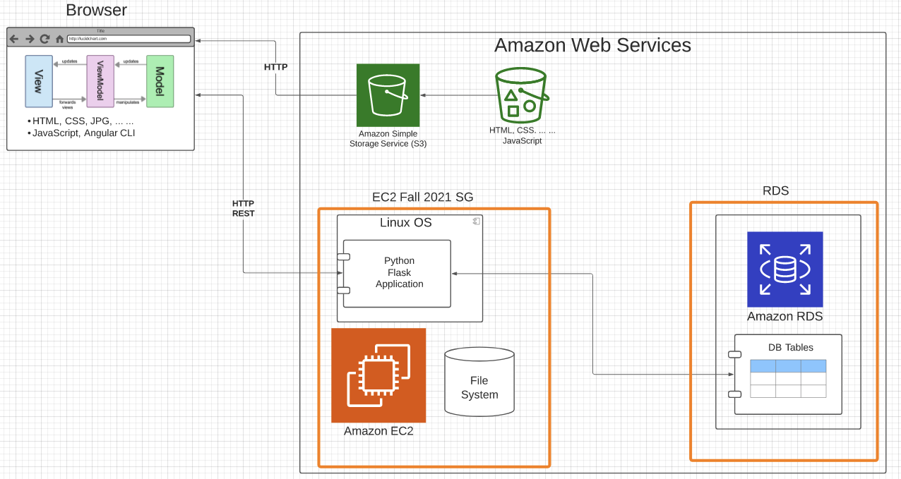
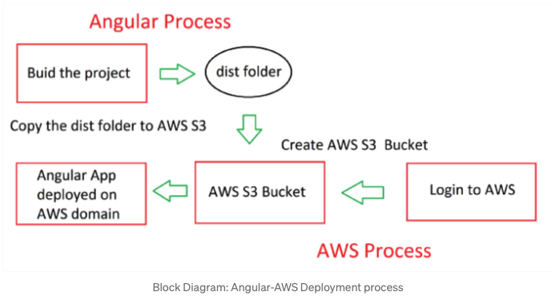
Deploy to S3
https://baljindersingh013.medium.com/angular-app-deployment-with-aws-s3-42d9008734ab
Compile the browser application (ng build -- prod)
You can test with ng serve -- prod
Generates “bundles” that contain:
JavaScript application logic.
HTML, content, ... In the app logic.
Create an S3 bucket.
Upload files from /dist folder.
Enable static web hosting.
Set access permissions.
Set index.html.
We will learn how to automate later.

Slide 8
Walkthrough
Basics:
/Users/donaldferguson/Dropbox/000-NewProjects/W4111-FastAPI-IMDB-Solution
Local MySQL: GoT_Basics, classicmodels.
/Users/donaldferguson/Dropbox/000-NewProjects/current-dashboard
Cloud Deployment:
Angular project → S3.
IMDB-GoT microservice to one of our targets.
Relational data → RDS or something similar.
Show various S3 APIs
Show the setup of the bucket, uploading, ... ...
Explain end-to-end, including CDN.

Slide 9
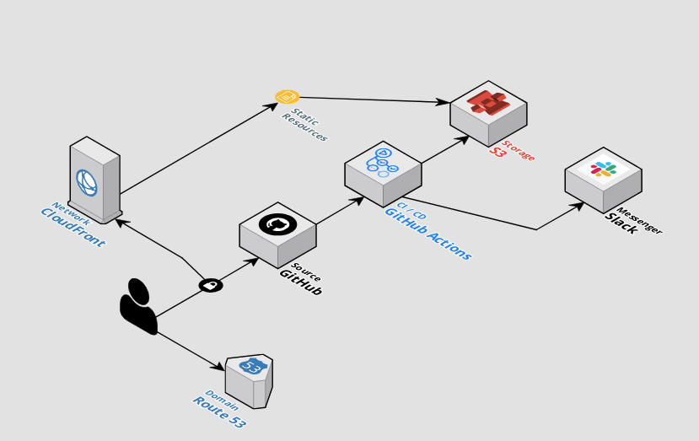
Automating Deployment
The previous slides showed manual steps to
Setup and configure.
“Deploy” the Angular application.
There are several ways to automate the process.
Automation using CLI scripts, Python scripts, ... ...
Higher layer frameworks, e.g. CloudFormation, Terraform, ... ...
GitHub actions.
... ...
https://github.com/byangular/angular-github-actions-s3-deploy
One of many tutorials and tools.

Slide 10
Introduction to PaaS Elastic Beanstalk
10 | E6156 – Topics in SW Engineering: Cloud Computing: Lecture 2 – Microservices, REST, Containers, PaaS, S3 © Donald F. Ferguson, 2021

Slide 11
Platform-as-a-Service
” Platform as a service (PaaS) is an enabler for software development where a third-party service provider delivers a platform to customers so they can develop, run, and manage software applications without the need to build and maintain the underlying infrastructure themselves.” (https://www.infoworld.com/article/3223434/what-is-paas-a-simpler-way-to-build-software-applications.html)
“Platform as a service (PaaS) is a complete development and deployment environment in the cloud, with resources that enable you to deliver everything from simple cloud-based apps to sophisticated, cloud-enabled enterprise applications. ... ... PaaS allows you to avoid the expense and complexity of buying and managing software licenses, the underlying application infrastructure and middleware, container orchestrators such as Kubernetes, or the development tools and other resources. You manage the applications and services you develop, and the cloud service provider typically manages everything else. (https://azure.microsoft.com/en-us/overview/what-is-paas/)

Slide 12
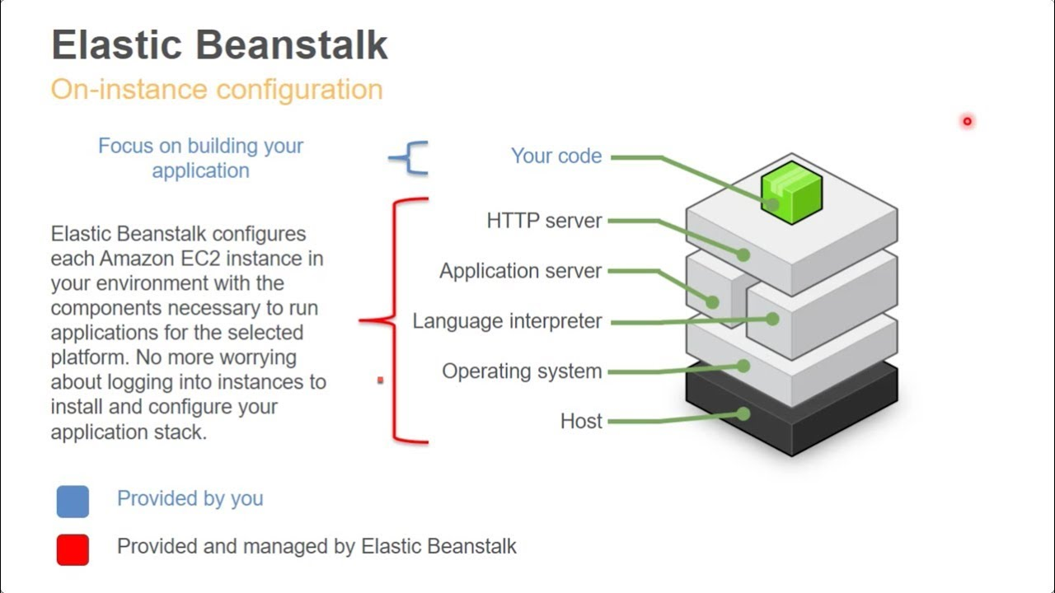
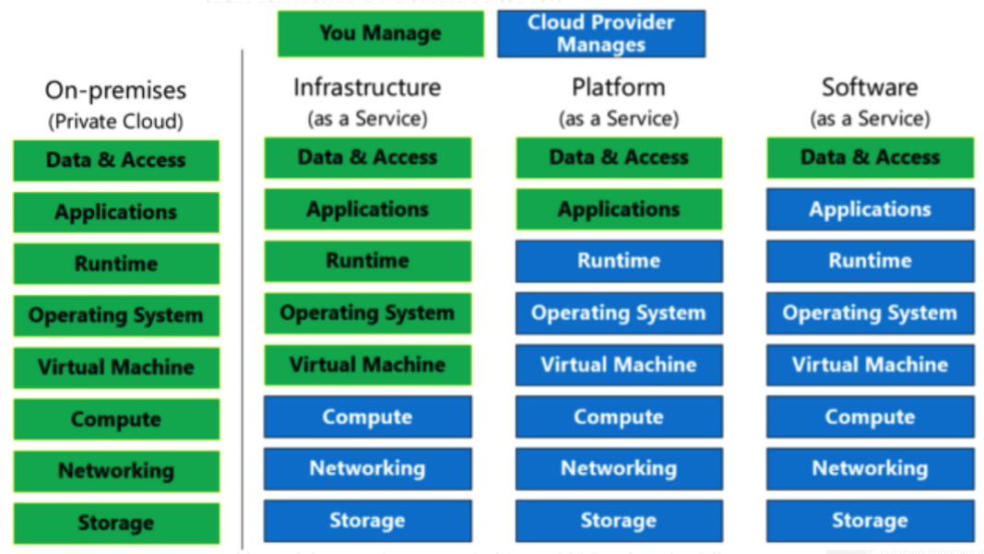
Platform-as-a-Service
Simplistically, PaaS adds two additional layers on top of IaaS:
Runtime means the language environment, libraries, etc. your application needs. For example, in our case this will mean a predefined and configured Flask environment.
“Middleware is a type of computer software that provides services to software applications beyond those available from the operating system.” (https://en.wikipedia.org/wiki/Middleware)
Basically, you do not have to build an application execution environment by installing libraries, services, ... You application “goes into a premade environment.”
Less flexible and customizable than IaaS but can be more productive to use for application scenarios.

Slide 13
Clarifying PaaS
This is a little hard to understand until you have done it a few times.
IaaS basically stops at the operating system layer. You are responsible for everything else your application code needs:
Database
Logging Service
... ...
PaaS provides a prebuilt environment with “your code goes here.”
The easiest way to see the difference is
You are using EC2.
We will use a PaaS (Google AppEngine because Beanstalk is terrible) And you will get a feel for the differences.
So, let’s do this.

Slide 14
Examples
/Users/donaldferguson/Dropbox/00-Fall-2023/Google/google_1
https://cloud.google.com/appengine/docs/legacy/standard/python/how-to
Show google console.
Note: I have coupons for Google and will distribute.
Show application.
Use ”free” for now.
Quick walkthrough of AWS Elastic BeanStalk

Slide 15
Function-as-a-Service
15 | E6156 – Topics in SW Engineering: Cloud Computing: Lecture 2 – Microservices, REST, Containers, PaaS, S3 © Donald F. Ferguson, 2021

Slide 16
Serverless and Function-as-a-Service
Serverless computing is a cloud computing execution model in which the cloud provider runs the server, and dynamically manages the allocation of machine resources. Pricing is based on the actual amount of resources consumed by an application, rather than on pre-purchased units of capacity.^{[1]} It can be a form of utility computing. Serverless computing can simplify the process of deploying code into production. Scaling, capacity planning and maintenance operations may be hidden from the developer or operator. Serverless code can be used in conjunction with code deployed in traditional styles, such as microservices. Alternatively, applications can be written to be purely serverless and use no provisioned servers at all.^{[2]} This should not be confused with computing or networking models that do not require an actual server to function, such as peer-to-peer (P2P).”
Function as a service (FaaS) is a category of cloud computing services that provides a platform allowing customers to develop, run, and manage application functionalities without the complexity of building and maintaining the infrastructure typically associated with developing and launching an app.^{[1]} Building an application following this model is one way of achieving a "serverless" architecture, and is typically used when building microservices applications.”
That was baffling:
IaaS, CaaS – You control the SW stack and the cloud provides (virtual) HW.
PaaS – The cloud hides the lower layer SW and provides an application container (e.g. Flask) with “Your code goes here.” You are aware of container.
FaaS – The cloud provides the container, and you implement functions (corresponding to routes in REST).

Slide 17
Serverless and Function-as-a-Service
https://medium.com/@tanmayct/serverless-architecture-function-as-a-service-19e127b8c990

Slide 18









What is Serverless Good/Not Good For ... ...
Serverless is good for
short-running
stateless
event-driven
Serverless is not good for
long-running
stateful
number crunching
Microservices
Databases
Mobile Backends
Deep Learning Training
Bots, ML Inferencing
Heavy-Duty Stream Analytics
IoT
f(x)
Numerical Simulation
Modest Stream Processing
Video Streaming
Service integration

Slide 19
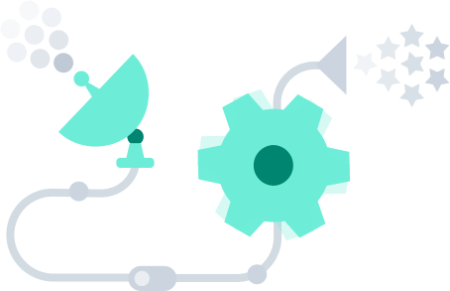
What triggers code execution?
Runs code in response to events
Event-programming model
Notes:
What is Serverless

Slide 20


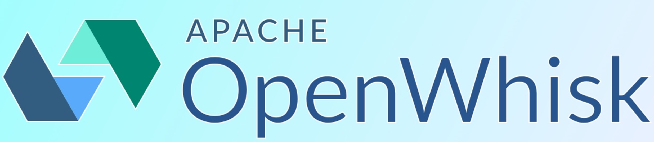
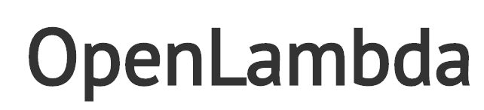

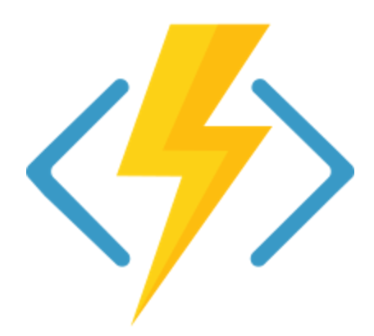
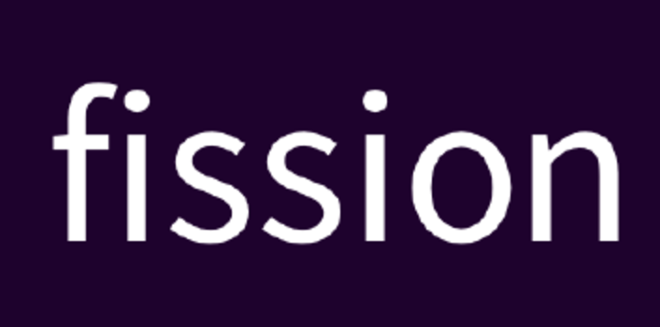
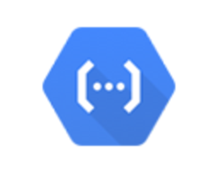

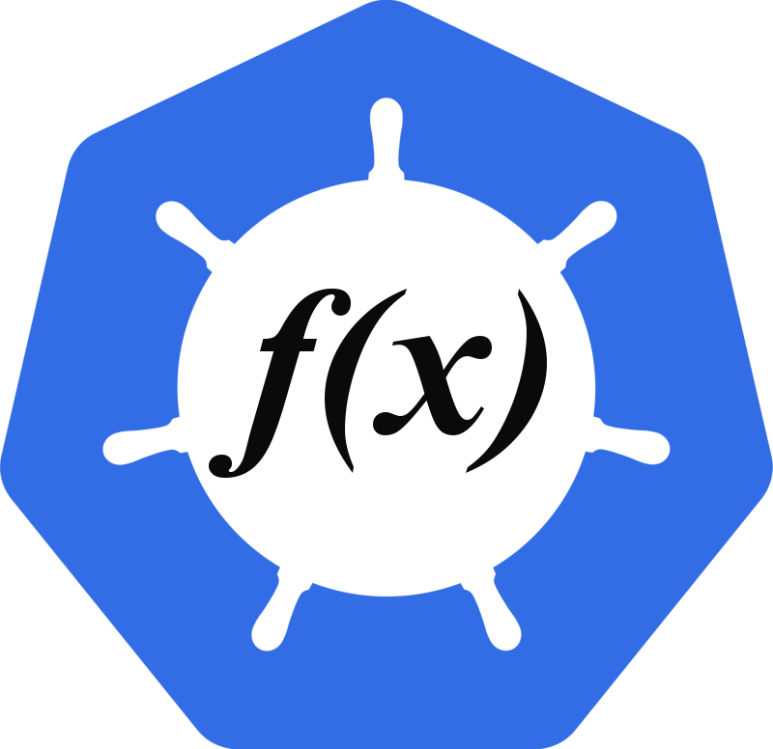

(Some) Current Platforms for Serverless
AWS Lambda
Azure Functions
Kubernetes
IBM Cloud Functions
Red-Hat
Google Functions
Notes:
Auth0, Twitter, ..
And many more upcoming / open source

Slide 21
Let’s Build a Lambda Function
We are going to do it manually to understand the process/steps.
Do through the console starting with a template.
Publish through API GW
Explain the concepts of events and how we will use.
There are several more complete approaches:
Pipelines
Serverless Framework (https://www.serverless.com/framework/docs/providers/aws/guide/intro)
AWS Toolkit for PyCharm (https://aws.amazon.com/pycharm/)
We will explore some of these ... ...

Slide 22
Data-as-a-Service
22 | E6156 – Topics in SW Engineering: Cloud Computing: Lecture 2 – Microservices, REST, Containers, PaaS, S3 © Donald F. Ferguson, 2021

Slide 23
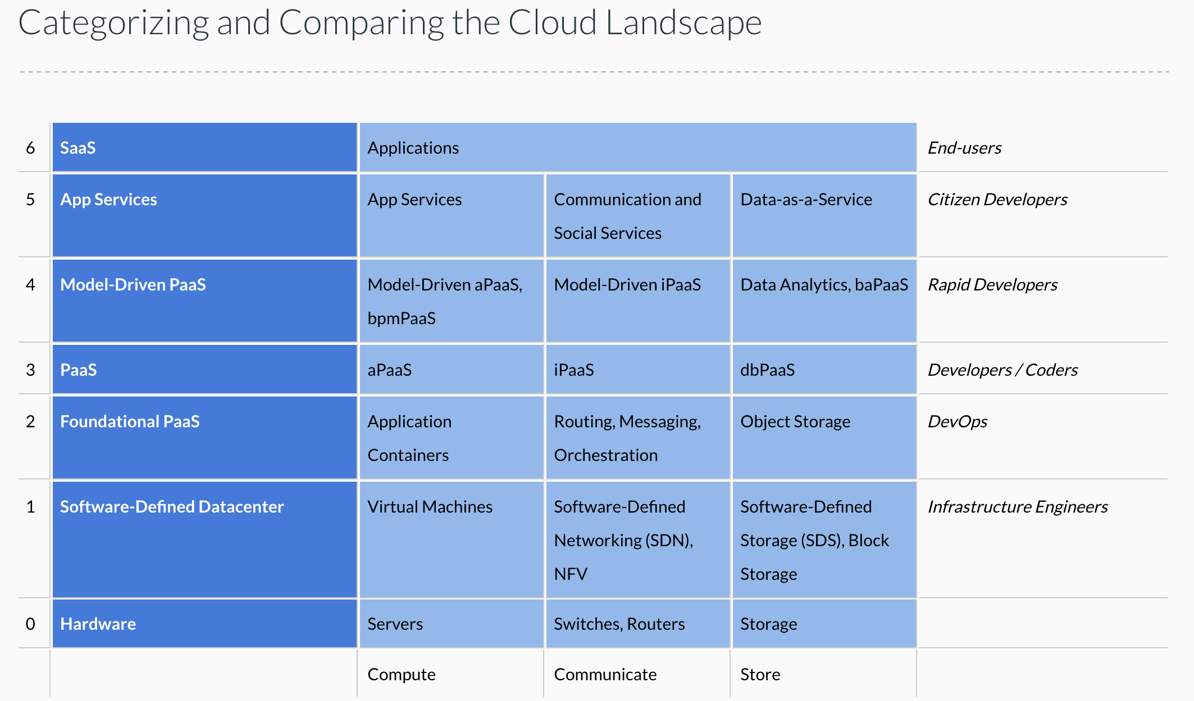
Cloud Concepts – One Perspective
http://www.theenterprisearchitect.eu/blog/2013/10/12/the-cloud-landscape-described-categorized-and-compared/

Slide 24
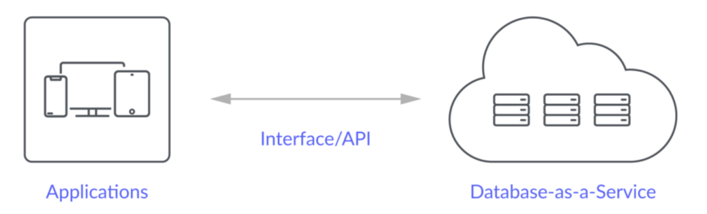
Database-as-a-Service
“A cloud database is a database that typically runs on a cloud computing platform and access to the database is provided as-a-service. There are two common deployment models: users can run databases on the cloud independently, using a virtual machine image, or they can purchase access to a database service, maintained by a cloud database provider. Of the databases available on the cloud, some are SQL-based and some use a NoSQL data model.
Database services take care of scalability and high availability of the database. Database services make the underlying software-stack transparent to the user.” (Wikipedia)
Let’s take a look at 3: Relational Data Service, Dynamo DB, MongoDB (Compass)

Slide 25
Walkthrough
RDS
Setup and configuration
DataGrip
Use from a program
Google equivalent.

Slide 26
Diagram of First Major Deliverable and What I am Doing this Weekend
26 | E6156 – Topics in SW Engineering: Cloud Computing: Lecture 2 – Microservices, REST, Containers, PaaS, S3 © Donald F. Ferguson, 2021

